Slide 1

WALMART SALES PERFORMANCE DASHBOARD
DRIVING INSIGHTS FROM WEEKLY SALES DATA
PRESENTED BY:
PALASH MUKHERJEE
26 JUNE, 2025

Slide 2
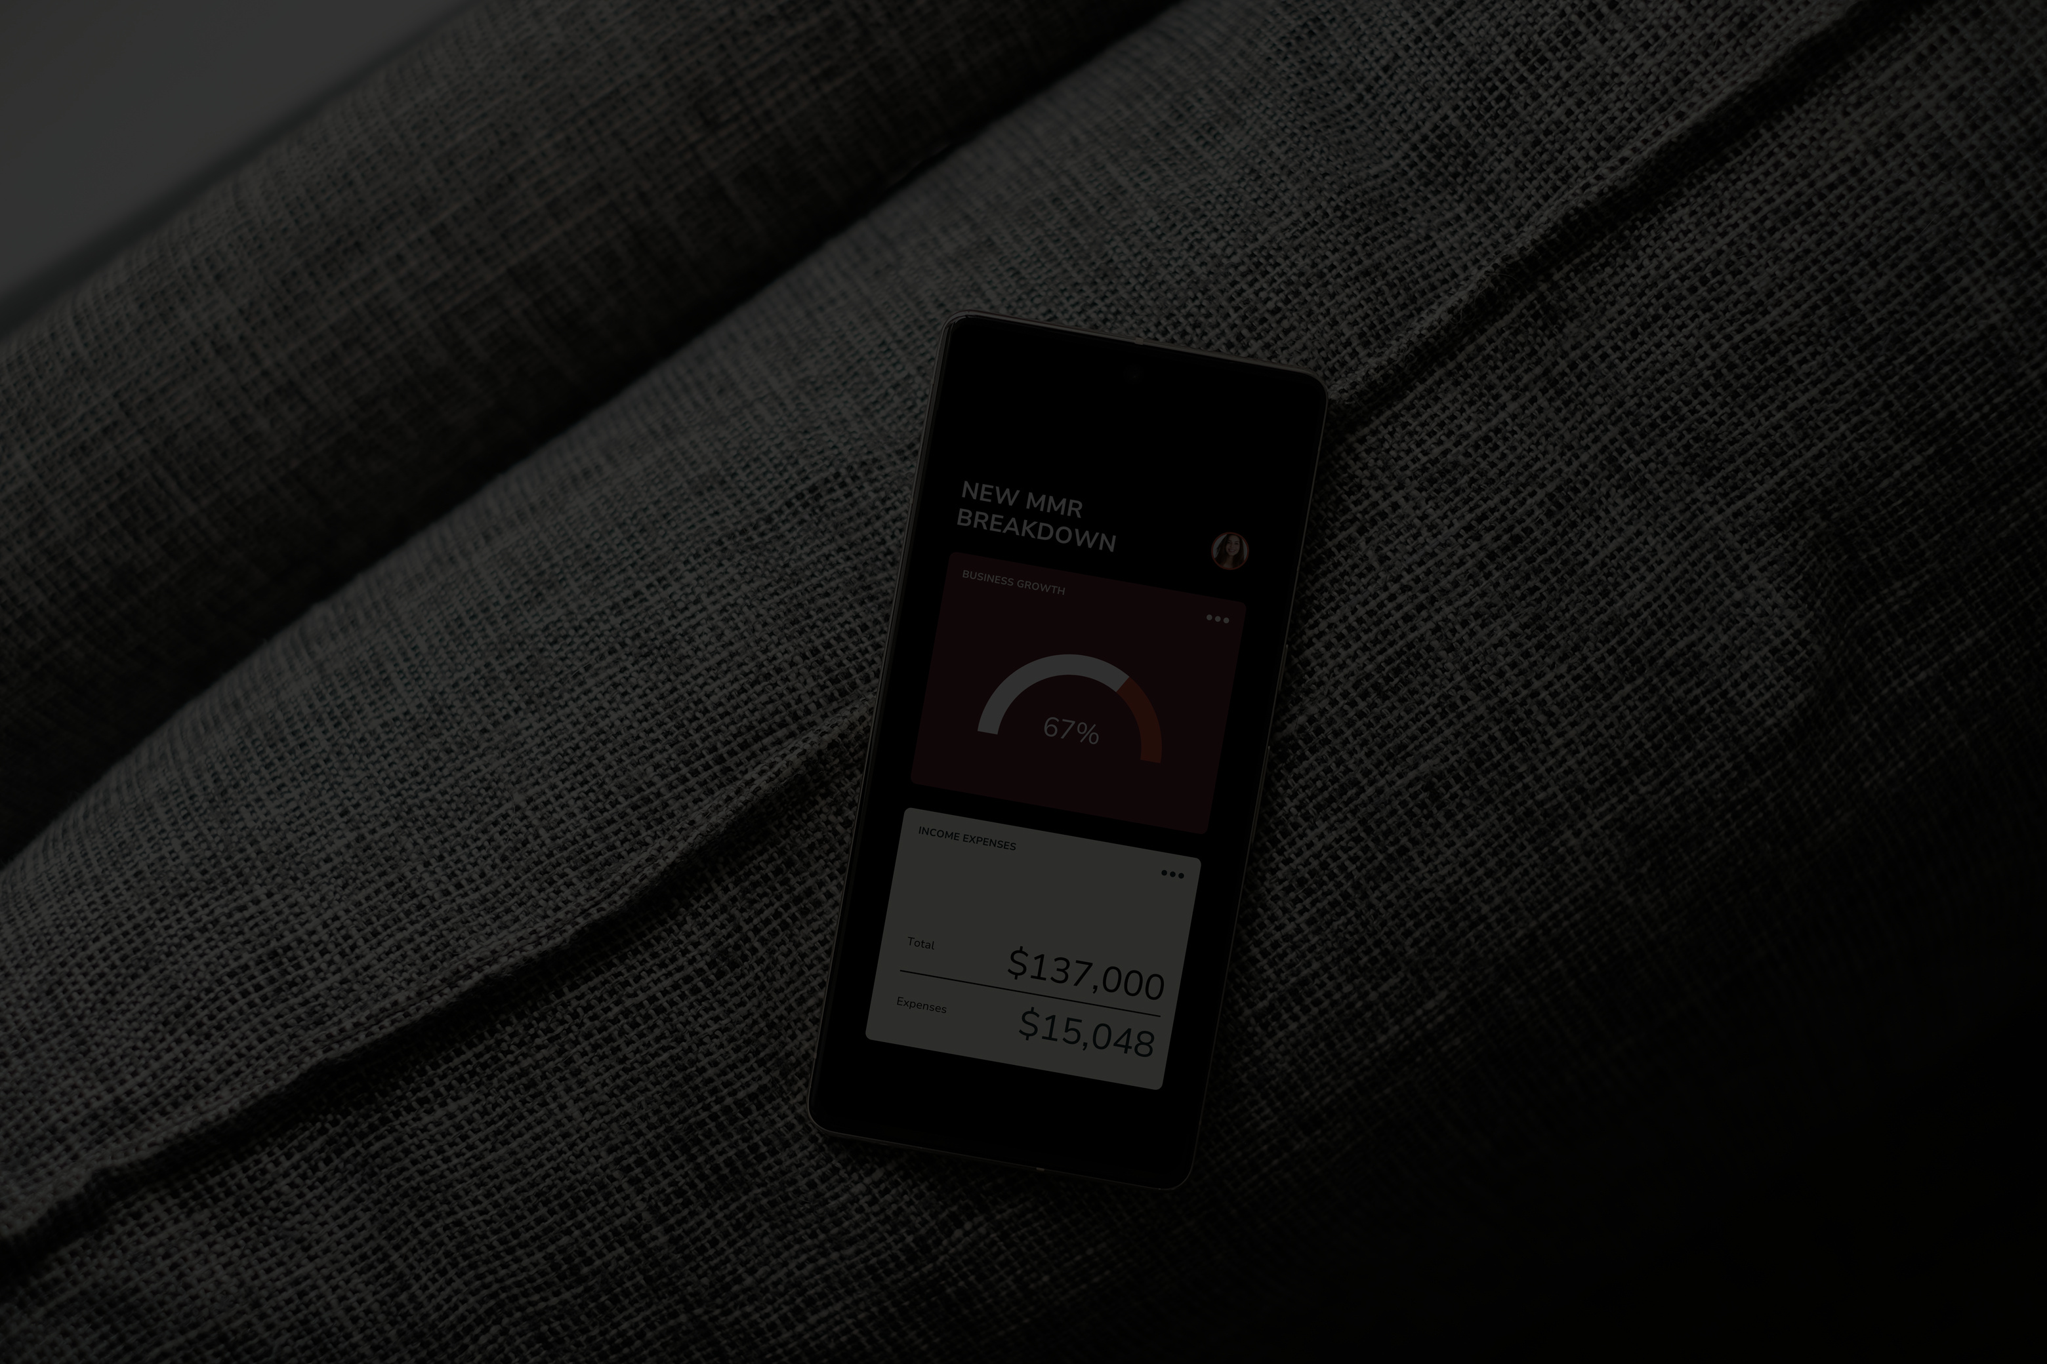
PROJECT OBJECTIVE
To design and implement an interactive dashboard for business stakeholders, providing clear, actionable insights into Walmart's weekly sales performance.
KEY GOALS
Monitor overall sales trends.
Identify top-performing stores.
Understand the impact of holiday weeks on sales.
Explore relationships between sales and external factors (e.g., unemployment, fuel prices).

Slide 3

DATA OVERVIEW & TOOLS
DATA SOURCE
https://github.com/Palash0321/Walmart_Sales_Dashboard/blob/main/Walmart_Sales.csv
Contains historical weekly sales figures, along with store ID, date, holiday flag, temperature, fuel price, CPI, and unemployment rate.
TOOLS USED
Python (Pandas): For initial data preparation and cleaning (e.g., ensuring correct date formats, checking for missing values/duplicates).
Tableau: For creating the interactive visualizations and dashboard.

Slide 4

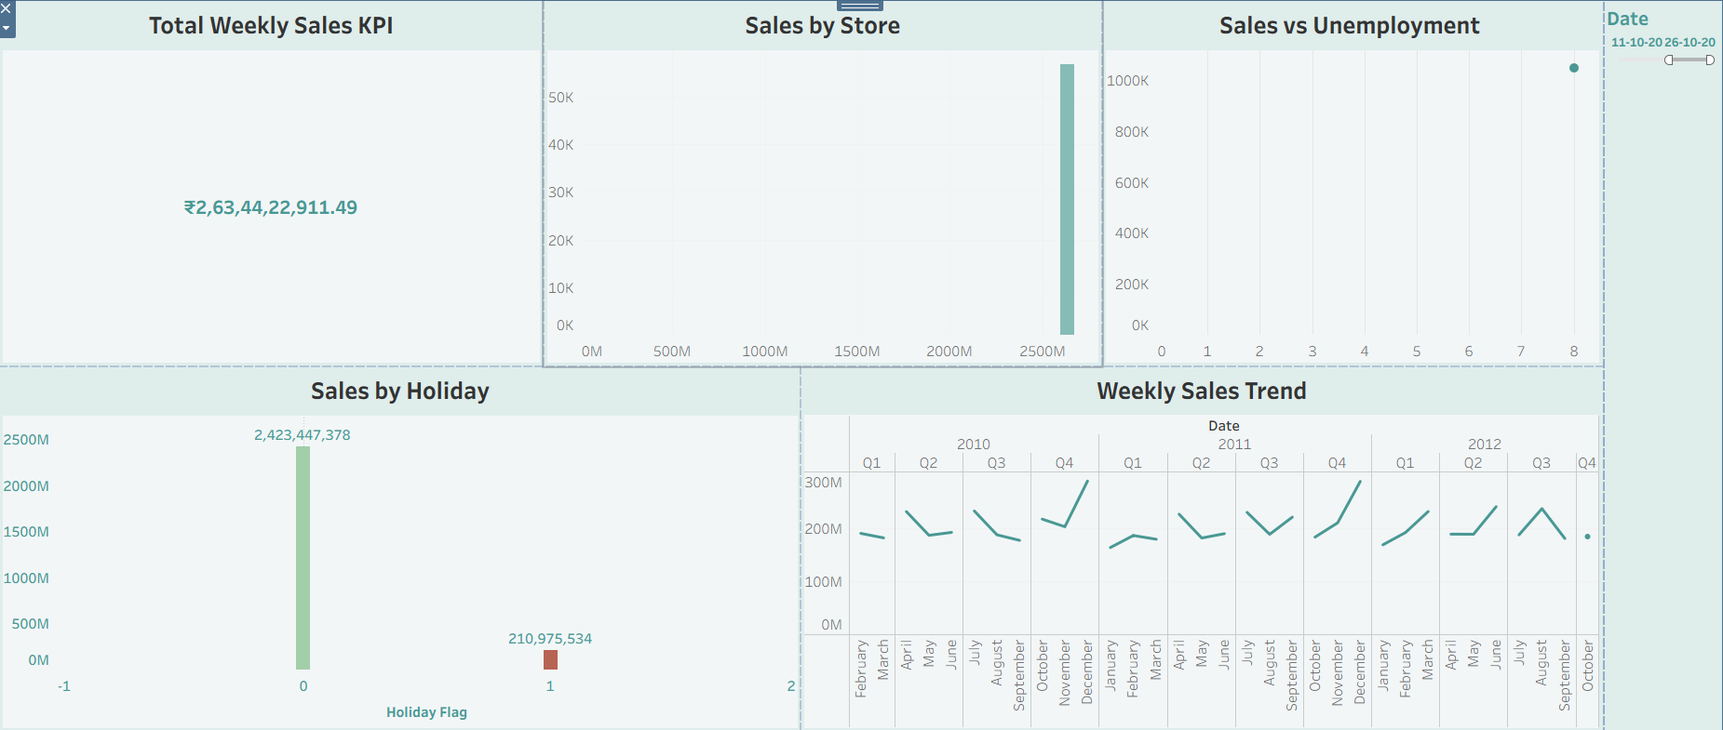
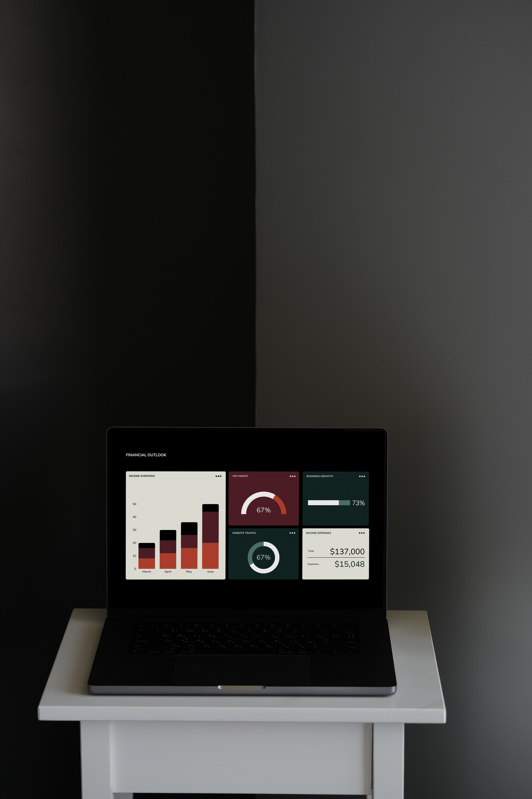
KEY DASHBOARD SECTIONS & KPIS
Our dashboard is organized to provide a comprehensive view of sales performance:
1. KEY PERFORMANCE INDICATORS (KPIS):
Total Weekly Sales: A prominent card displaying the overall sum of sales across all stores and periods.
Average Weekly Sales: Another card showing the average weekly sales figure.
2. WEEKLY SALES TREND:
A Line Chart showing Weekly_Sales over Date, revealing seasonal patterns and overall growth/decline.
3. SALES BY STORE:
A Bar Chart highlighting sales performance across individual Walmart stores, sorted by total sales.
4. SALES BY HOLIDAY/NON-HOLIDAY:
A Bar Chart comparing total sales during holiday weeks versus non-holiday weeks, using the Holiday_Flag.
5. SALES VS. ECONOMIC FACTORS (E.G., UNEMPLOYMENT/TEMPERATURE):
An Exploratory Chart (e.g., Scatter Plot) to visualize potential correlations between Weekly_Sales and factors like Unemployment or Temperature.

Slide 5

KEY INSIGHTS & FINDINGS
Overall Sales Performance: [State the total sales number from your dashboard] indicates strong overall sales.
Sales Trends: [Describe the trend – e.g., "Sales show a consistent upward trend over the years," or "Sales peak during certain months/quarters due to seasonality."].
Holiday Impact: [State your finding – e.g., "Holiday weeks consistently drive higher sales, demonstrating their importance," or "The impact of holidays is [specific observation]."].
Top Performing Stores: [Mention 1-2 top store IDs or a general observation – e.g., "Store X and Store Y are consistently the highest revenue generators."].
Economic Influence: [If you found a correlation, state it – e.g., "There appears to be an inverse relationship between unemployment and sales, as unemployment decreases, sales tend to rise." Or "Temperature shows no clear direct correlation with sales."]

Slide 6

INTERACTIVITY & RECOMMENDATIONS
Interactive Features:
Filters/Slicers: Users can filter the entire dashboard by Date Range, Store ID, and Holiday/Non-Holiday status for deeper dives.
Click-to-Filter: Charts can be set up to filter others (e.g., clicking on a store in the "Sales by Store" chart updates the "Sales Trend" for that specific store).
Recommendations:
Strategic Planning: Use holiday sales insights for better inventory management and marketing campaigns during peak seasons.
Targeted Store Support: Investigate factors contributing to high sales in top stores, and apply learnings to lower-performing ones.
Economic Monitoring: Continue to monitor economic indicators like unemployment as they may influence sales performance.

Slide 7
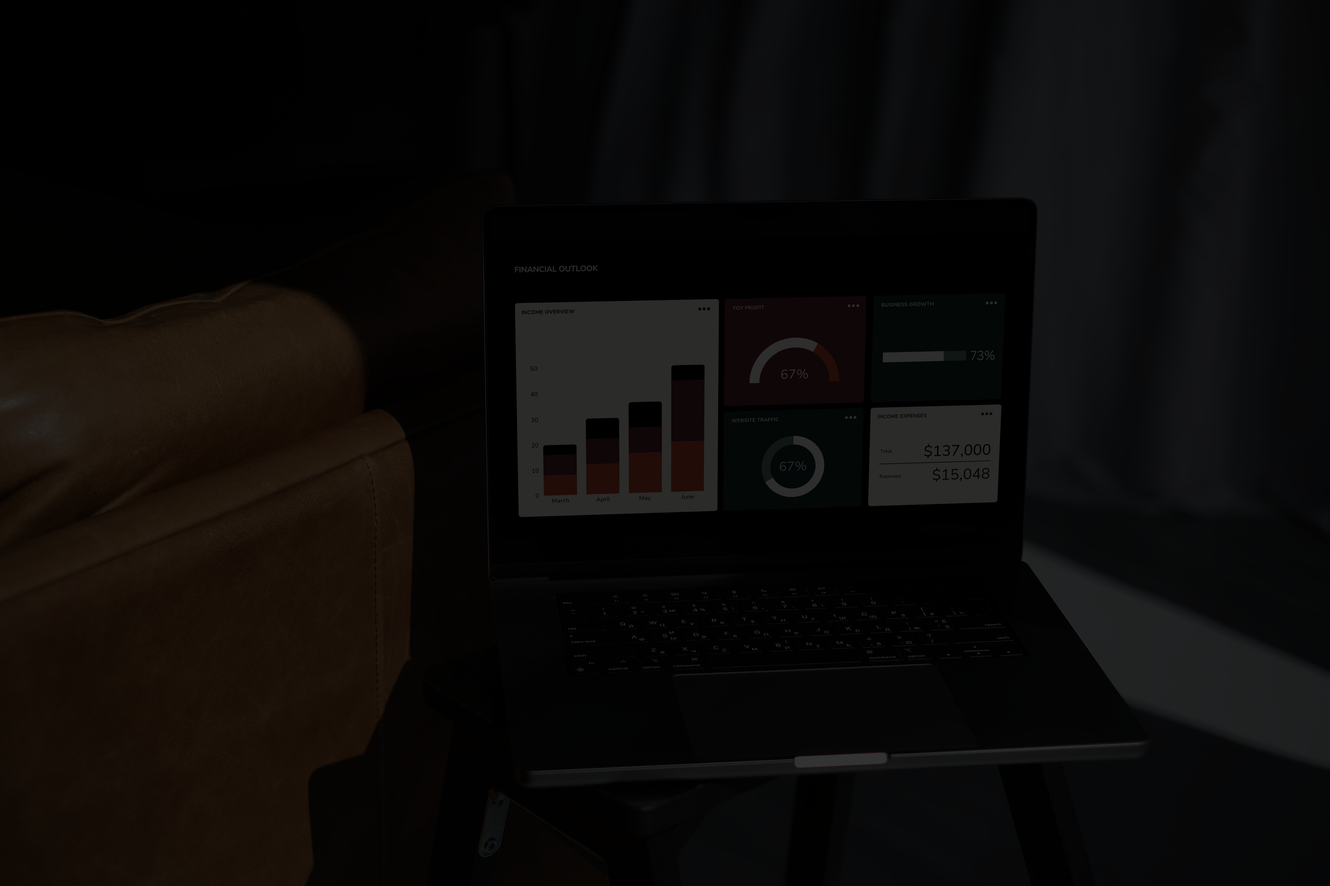
DASHBOARD VIEW

Slide 8
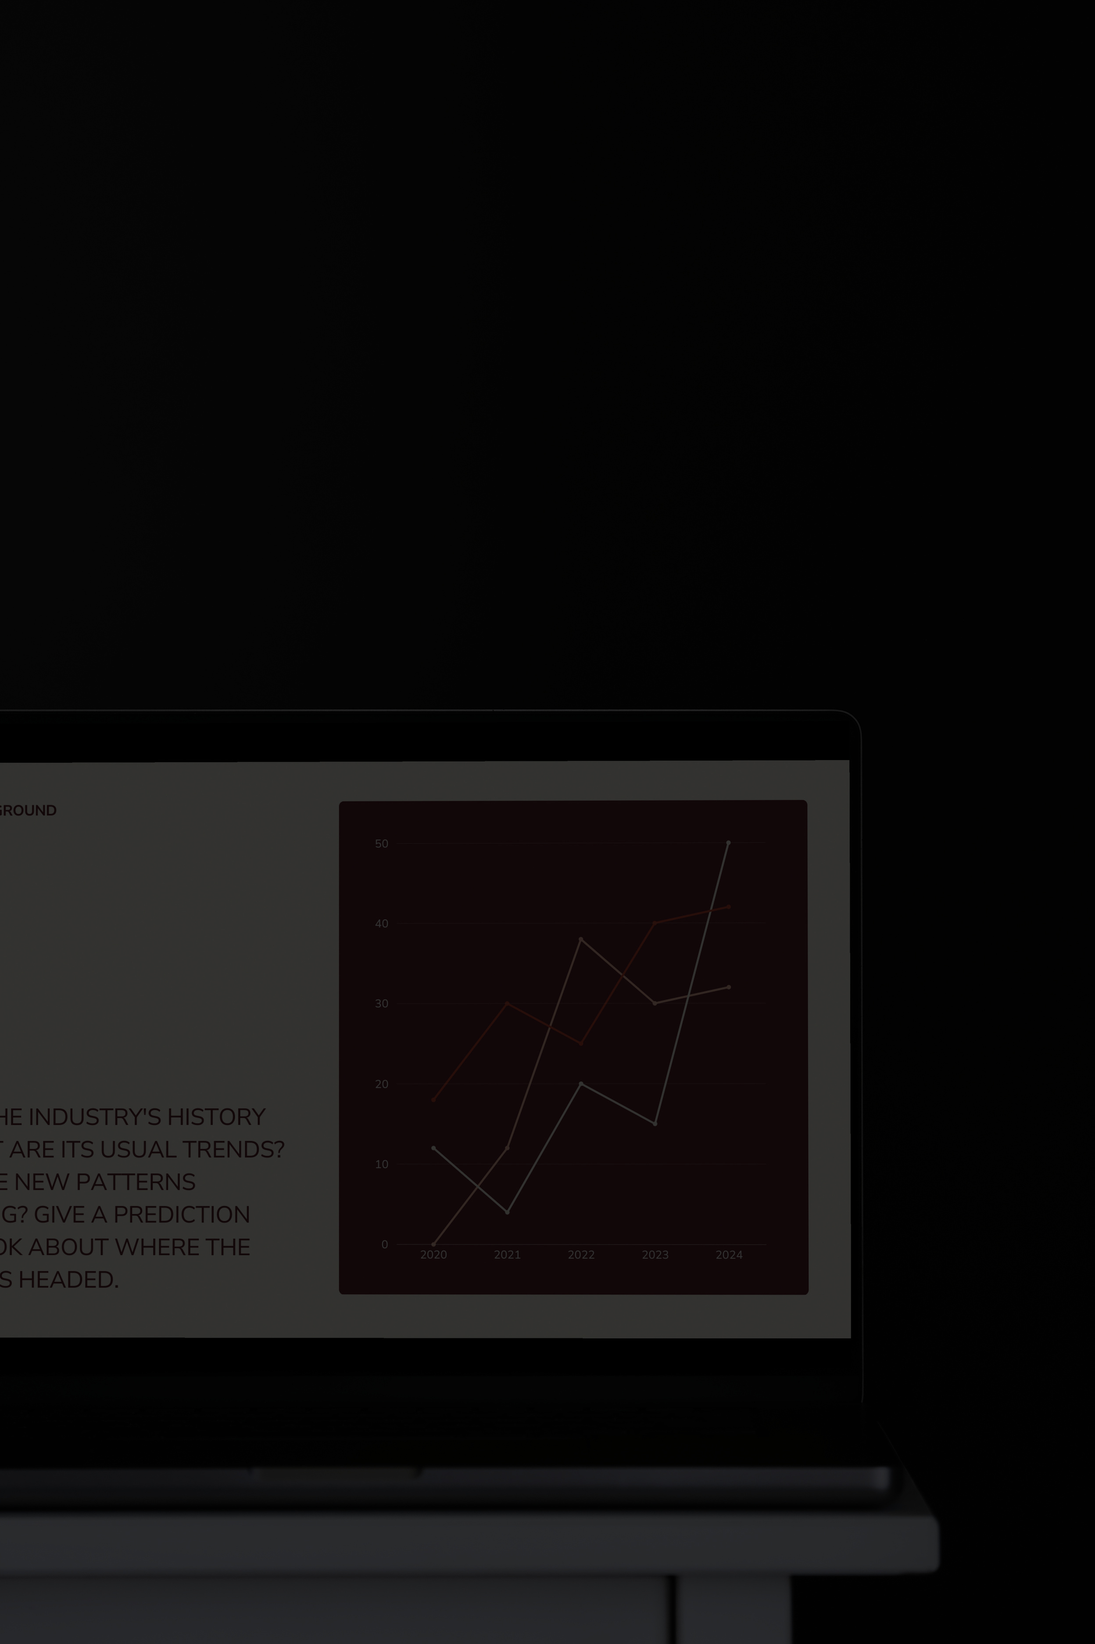
THANK YOU

